Slide 1

Bringing the Fire of God's Word to the Human Heart

Slide 2

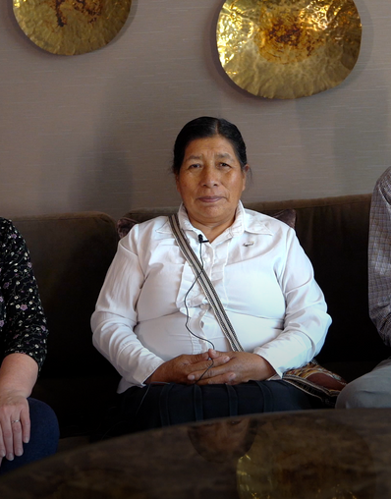
PASTOR MARCELINA PERU
"It's very important for us to be able to read the Bible in our own language, the language of our heart. The Quechua FireBible is going to be a weapon and a strong learning tool in our hands."
AT FIREBIBLE.ORG/STORIES

Slide 3
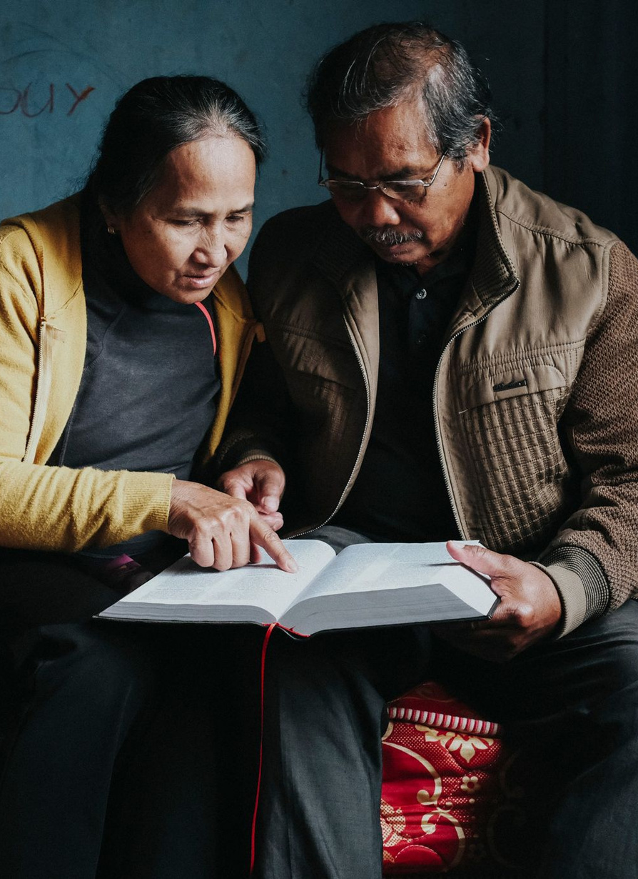
2025 FOCUS PROJECTS
Shangaana
SWEDISH
BANGLADESHI
Mozambique
Sweden
Bangladesh
QUECHUAN
MOORE
KAZAKH
Peru
Burkina Faso
Kazakhstan
LINGALA
AHKA
AMHARIC
Dem. Rep. of Congo
Thailand
Ethiopia
AT FIREBIBLE.ORG/2025FOCUSPROJECTS

Slide 4
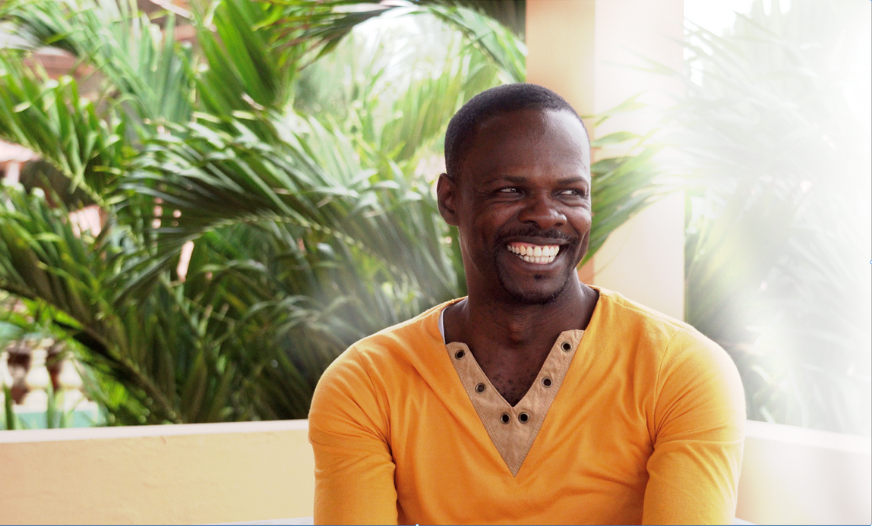
PASTOR DIGE HAITI
"A FireBible will give Haitian believers a clearer understanding. It's something lacking in the country. The FireBible will make a huge difference, and I thank the Lord for this project!"
AT FIREBIBLE.ORG/STORIES

Slide 5
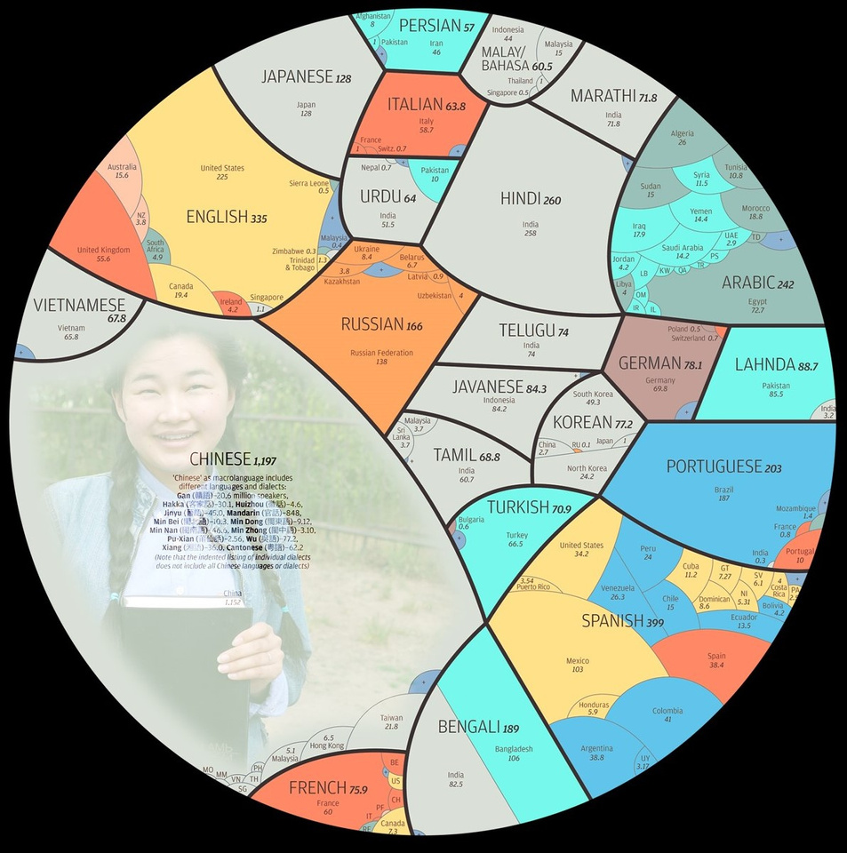
COMPLETED LANGUAGES
The Premier Study Bible for the Spirit-Led Believer!
FireBible is available in over 67 Heart Languages!
Every FireBible bought in America helps to finance the creation of a FireBible in a heart language overseas.
The FireBible assists those seeking to deepen their understanding of the Holy Spirit and His work.
AT FIREBIBLE.ORG/PROJECTS

Slide 6
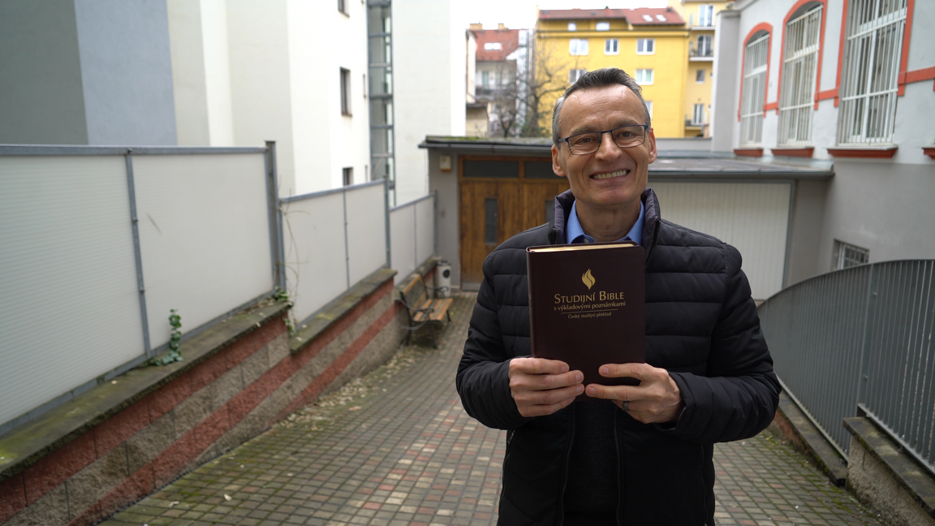
PETER KOZIC,MISSIONARY CZECH REPUBLIC
"In our church in the Czech Republic, there are a lot of people involved in ministry. Most of them don't have the time to study at Bible school, that's why we need proper tools to give them a proper picture of God's Word.The FireBible introduces people to the main facts of God's Word."
AT FIREBIBLE.ORG/STORIES

Slide 7
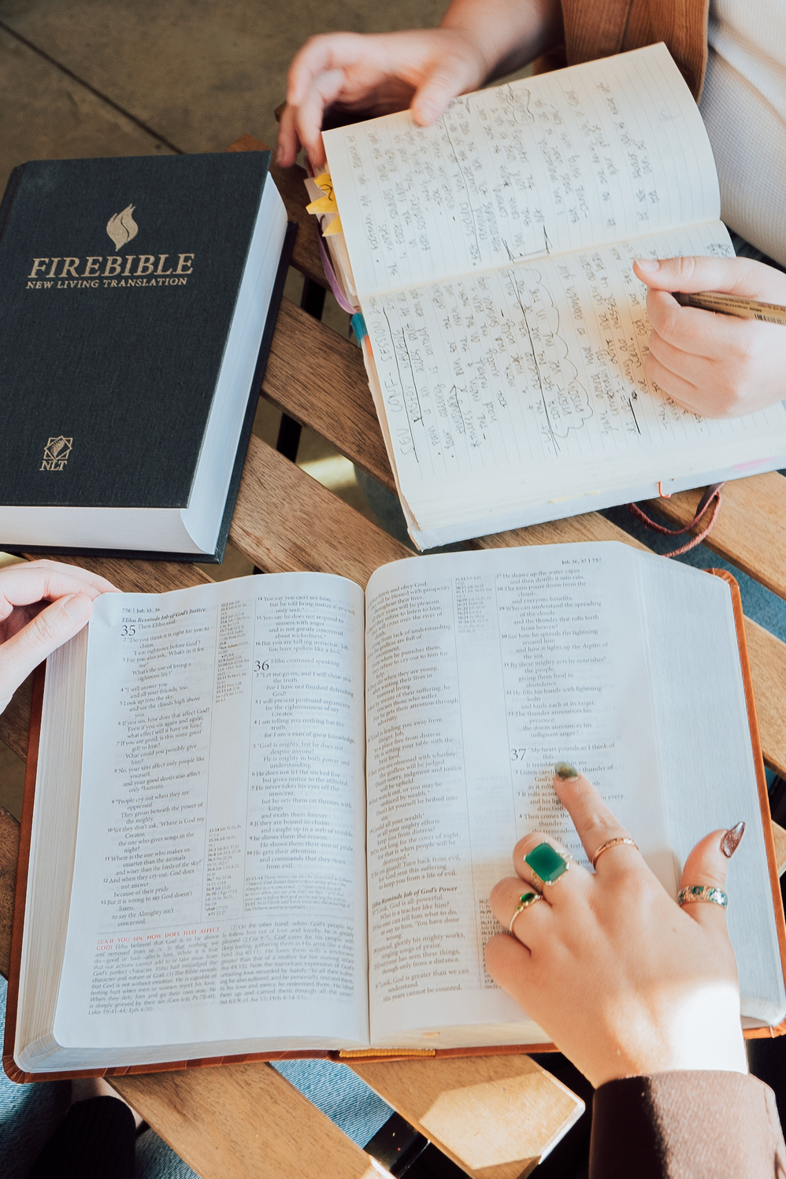
STORE
ORDER ALL YOUR FIREBIBLES AT FIREBIBLE.ORG/STORE
NLT, ESV, MEV, KJV
SPANISH RVR, RVC
Special Editions for Kids, Students, Large Print, and Military
AT FIREBIBLE.ORG/STORE

Slide 8
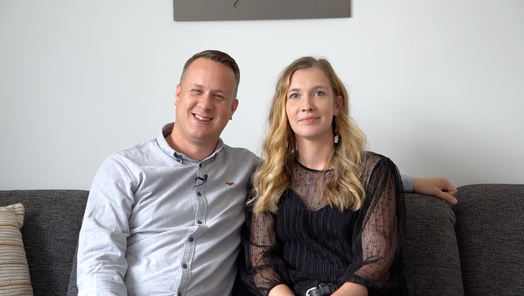
DAN BLAIR,MISSIONARY SLOVENIA
"Many of our pastors don't have formal training because we don't have a seminary in the country. Having a Study Bible like the FireBible is a great tool for our pastors and a resource for them to continue their studies and develop their skills."
AT FIREBIBLE.ORG/STORIES

Slide 9
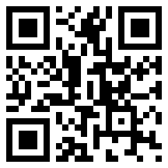
SCAN THE QR CODE AND
STAY CONNECTED!

